Slide 1

Modern Programming Tools And Techniques-I Lecture 10: Wrapper Classes
Lovely Professional University, Punjab

Slide 2
Introduction
Most of the objects collection store objects and not primitive types.
Primitive types can be used as object when required.
As they are objects, they can be stored in any of the collection and pass this collection as parameters to the methods.

Slide 3
Wrapper Class
Wrapper classes are classes that allow primitive types to be accessed as objects.
Wrapper class is wrapper around a primitive data type because they "wrap" the primitive data type into an object of that class.

Slide 4
What is Wrapper Class?
Each of Java's eight primitive data types has a class dedicated to it.
They are one per primitive type: Boolean, Byte, Character, Double, Float, Integer, Long and Short.
Wrapper classes make the primitive type data to act as objects.

Slide 5
Primitive Data Types and Wrapper Classes
Data Type | Wrapper Class
byte | Byte
short | Short
int | Integer
long | Long
char | Character
float | Float
double | Double
boolean | Boolean

Slide 6
Difference b/w Primitive Data Type and Object of a Wrapper Class
The following two statements illustrate the difference between a primitive data type and an object of a wrapper class:
int x = 25;
Integer y = new Integer(33);

Slide 7

The first statement declares an int variable named x and initializes it with the value 25.

Slide 8

The second statement instantiates an Integer object. The object is initialized with the value 33 and a reference to the object is assigned to the object variable y.

Slide 9
What is the need of Wrapper Classes?
Wrapper classes are used to be able to use the primitive data-types as objects.
Many utility methods are provided by wrapper classes.
To get these advantages we need to use wrapper classes.

Slide 10
What is the need of Wrapper Classes?
There are three reasons that we might use a Number object rather than a primitive:
As an argument of a method that expects an object (often used when manipulating collections of numbers).
To use constants defined by the class, such as MIN_VALUE and MAX_VALUE, that provide the upper and lower bounds of the data type.
To use class methods for converting values to and from other primitive types, for converting to and from strings, and for converting between number systems (decimal, octal, hexadecimal, binary).

Slide 11
Boxing and Unboxing
The wrapping is done by the compiler.
if we use a primitive where an object is expected, the compiler boxes the primitive in its wrapper class.
Similarly, if we use a number object when a primitive is expected, the compiler un-boxes the object.
Example of boxing and unboxing:
Integer x, y; x = 12; y = 15; System.out.println(x+y);
When x and y are assigned integer values, the compiler boxes the integers because x and y are integer objects.
In the println() statement, x and y are unboxed so that they can be added as integers.

Slide 12
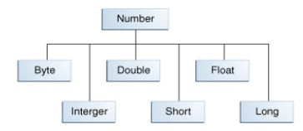
Numeric Wrapper Classes
All of the numeric wrapper classes are subclasses of the abstract class Number .
Short, Integer, Double and Long implement Comparable interface.

Slide 13
Numeric Type Wrapper Classes
All of the numeric type wrappers inherit the abstract class Number.
Number declares methods that return the value of an object in each of the different number formats. These methods are shown here:
byte byteValue( )
double doubleValue( )
float floatValue( )
int intValue( )
long longValue( )
short shortValue( )
For example, doubleValue( ) returns the value of an object as a double, floatValue( ) returns the value as a float, and so on.
These methods are implemented by each of the numeric type wrappers.

Slide 14
Features of Numeric Wrapper Classes
Provides a way to store primitive data in an object.
All numeric wrapper classes implement typeValue() method.
This method returns the value of the object as its primitive type.
byteValue(), intValue(), floatValue(), doubleValue() etc.
Example:
Integer a = 10; System.out.println(a.floatValue());

Slide 15
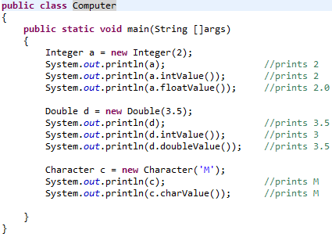
Example

Slide 16
Features of Numeric Wrapper Classes
All the numeric wrapper classes provide a method to convert a numeric string into a primitive value.
public static type parseType (String Number)
parseInt()
parseFloat()
parseDouble()
parseLong()
…

Slide 17
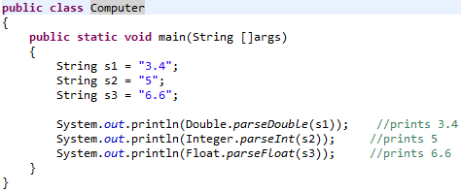
Example

Slide 18

Features of Numeric Wrapper Classes
All the wrapper classes provide a static method toString to provide the string representation of the primitive values
public static String toString (type value)
Example:
public static String toString (int a)

Slide 19
Features of Numeric Wrapper Classes
All numeric wrapper classes have a static method valueOf, which is used to create a new object initialized to the value represented by the specified string.
public static DataType valueOf (String s)
Example:
Integer i = Integer.valueOf (“135”);
Double d = Double.valueOf (“13.5”);

Slide 20
Methods implemented by subclasses of Number
Converts the value of the Number object to the primitive data type returned.
byte byteValue() short shortValue() int intValue() long longValue() float floatValue() double doubleValue()

Slide 21
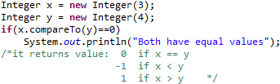
Methods implemented by subclasses of Number
Compares this Number object to the argument.
int compareTo(Byte anotherByte) int compareTo(Double anotherDouble) int compareTo(Float anotherFloat) int compareTo(Integer anotherInteger) int compareTo(Long anotherLong) int compareTo(Short anotherShort)

Slide 22

Methods implemented by subclasses of Number
boolean equals(Object obj)
Determines whether this number object is equal to the argument.
The methods return true if the argument is not null and is an object of the same type and with the same numeric value.

Slide 23
Integer Class
Constructors:
Integer(i) : constructs an Integer object equivalent to the integer i
Integer(s) : constructs an Integer object equivalent to the string s
Class Methods:
parseInt(s) : returns a signed decimal integer value equivalent to string s
toString(i) : returns a new String object representing the integer i

Slide 24
Instance Methods of Integer Class
byteValue() : returns the value of this Integer as a byte
doubleValue() : returns the value of this Integer as an double
floatValue() : returns the value of this Integer as a float
intValue() : returns the value of this Integer as an int
longValue() : returns the value of this Integer as a long
shortValue() : returns the value of this Integer as a short
toString() : returns a String object representing the value of this Integer

Slide 25
Character Class
Character is a wrapper around a char.
The constructor for Character is :
Character(char ch)
Here, ch specifies the character that will be wrapped by the Character object being created.
To obtain the char value contained in a Character object, call charValue( ), shown here:
char charValue( );
It returns the encapsulated character.

Slide 26
Boolean Class
Boolean is a wrapper around boolean values.
It defines these constructors:
Boolean(boolean boolValue)
Boolean(String boolString)
In the first version, boolValue must be either true or false.
In the second version, if boolString contains the string “true” (in uppercase or lowercase), then the new Boolean object will be true. Otherwise, it will be false.

Slide 27
To obtain a boolean value from a Boolean object, use booleanValue( ), shown here:
boolean booleanValue( )
It returns the boolean equivalent of the invoking object.

Slide 28


